Slide 1
2019 New York City Airbnb
Data Analytics
By :
Yexin Hu
Qian Zhang
Jiayue Niu

Slide 2
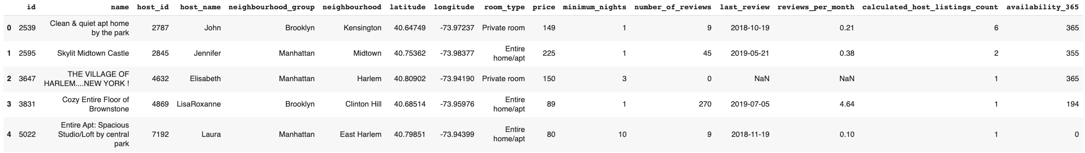
NYC Airbnb Background
4th most popular city in the world for booking, with properties listings projected to pass 70,000 by the end of 2020
Dataset:
Obtained from Kaggle.com
Over 48,000 listings in 2019 for NYC
15 features and 1 target variable
Notes:
We will begin with a brief introduction of the Airbnb marketplace in NYC:
4th most popular city for booking in the world: behind Tokyo, Paris, and Osaka.
The number of NYC Airbnb property listings is projected to pass 70,000 in 2020.
Dataset

Slide 3
Problem Statement
Goal of analysis: to help hosts and guests better navigate the NYC Airbnb marketplace.
Model Inputs: features such as location and room type
Model Outputs: listing price categories
Models used: PCA, KNN, Gradient Boosting, Logistic Regression, and Random Forest
Notes:
Goal of the analysis is to help hosts and guests better navigate the Airbnb marketplace specifically by understanding which type of property belongs to which pricing category.
Inputs to the models include essential property information specific to the listing such as neighbourhood and room type (e.g. single room in Kensington).
Outputs of the models are price categories of the listing (e.g. under $100 USD per night).
Models to be investigated include PCA, KNN, Logistic Regression, Gradient Boosting, and Random Forest.

Slide 4
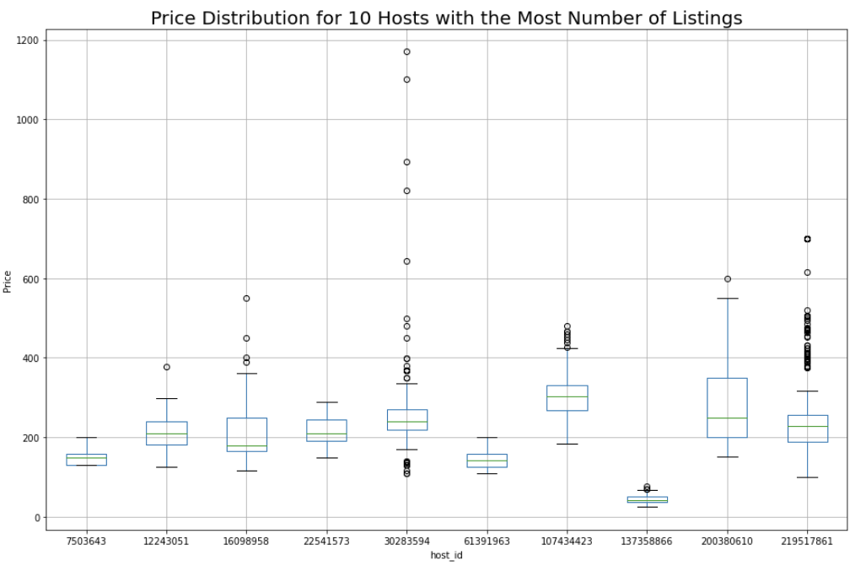
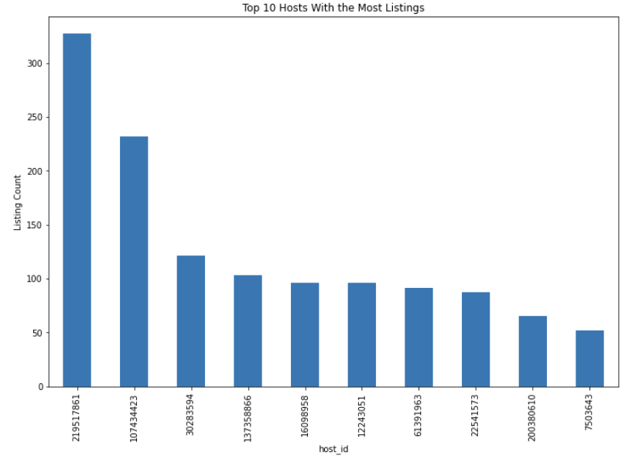
Listing Pricings from Top 10 Hosts
Notes:
Looking at the listings by top 10 hosts who have the most number of listings in the city:
On the left we have the distribution of listing quantities:
Number of listings range from over 300 to around 50 per host.
Right Chart: Listing prices from the top 10 hosts
Many of the top hosts offer a wide range of listings by price
Mean price at around 200 USD per night.
Outliers are mostly priced at 400 USD or more, with some over 1000 USD.

Slide 5
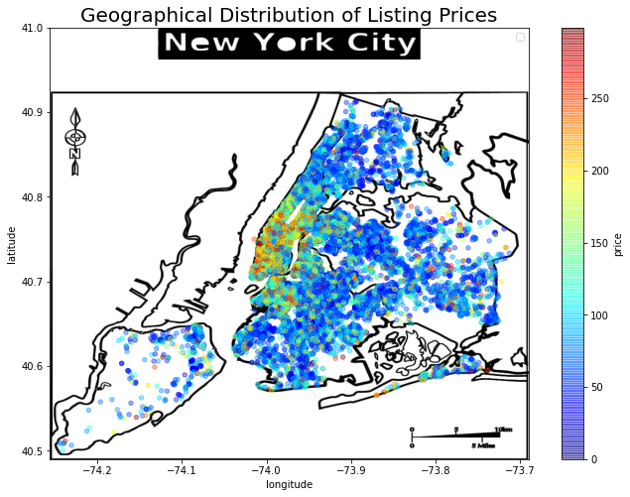
Geographical View of Listing Prices
High density near Manhattan and Brooklyn
Expensive listings mostly in the lower and midtown Manhattan areas
Sparse offerings in Staten Island
Notes:
Looking at the geographical distribution of listing prices:
Most of the listings are located in the central areas near Manhattan and Brooklyn
Listing density is also reflective of listing prices, with most expensive listings in lower and midtown Manhattan
There is relatively sparse offerings in the bottom left Staten Island area, which had only begun offering airbnb listings in 2016.

Slide 6
Class Definitions
Classes are defined as follow:
The class is defined based on common sense
Economy, standard and premium class
The classes are easy to interpret
Range | Count
Price <=100 | 23921
100<Price <=200 | 16578
Price > 200 | 8380

Slide 7
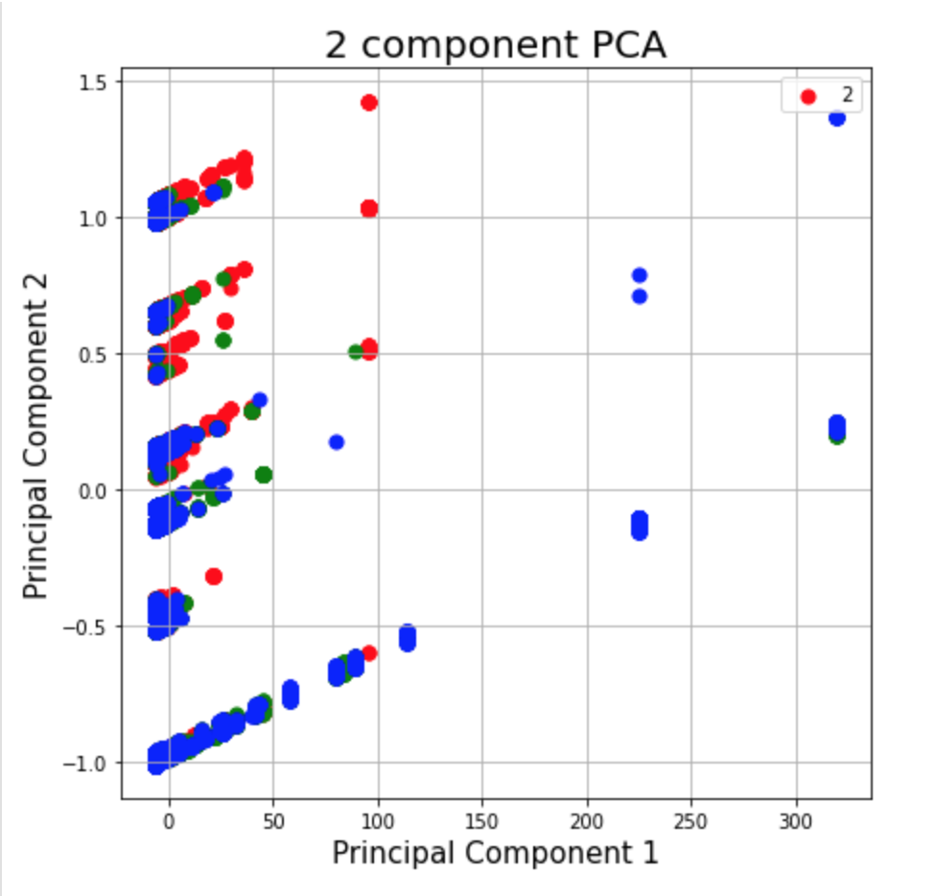
Principal Component Analysis
PCA does not show clear class among data points
Price classes are human defined, not inherent with data
Price data is continuous, there is no clear boundary for the data
Most of the features are categorical, dummy encoding increased the sparsity of the data

Slide 8
Supervised Algorithms and Evaluation Metrics
Rank | Model | Train Accuracy | Test Accuracy | F1-Score
1 | Gradient Boosting | 72.9% | 71.8% | 0.71
2 | Logistic Regression | 70.5% | 69.9% | 0.69
3 | Random Forest | 68.7% | 68.3% | 0.67
4 | K-Nearest Neighbor | 65.8% | 59.3% | 0.59
Only slight, insignificant improvement
Model | learning_rate | n_estimators | Train Accuracy | Test Accuracy | F1-Score
Gradient Boosting | 0.3 | 100 | 74.4% | 72.2% | 0.71

Slide 9
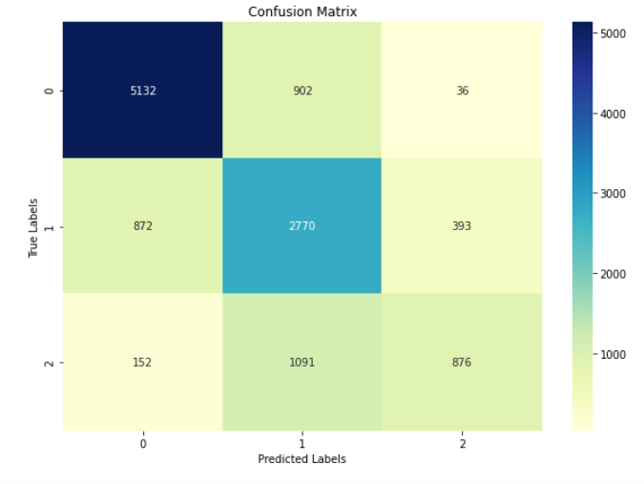
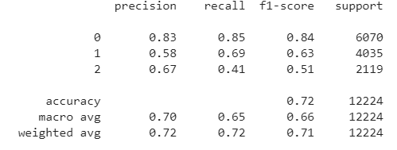
Results Interpretation
Notes:
The Gain implies the relative contribution of the corresponding feature to the model calculated by taking each feature's contribution for each tree in the model. A higher value of this metric when compared to another feature implies it is more important for generating a prediction.

Slide 10
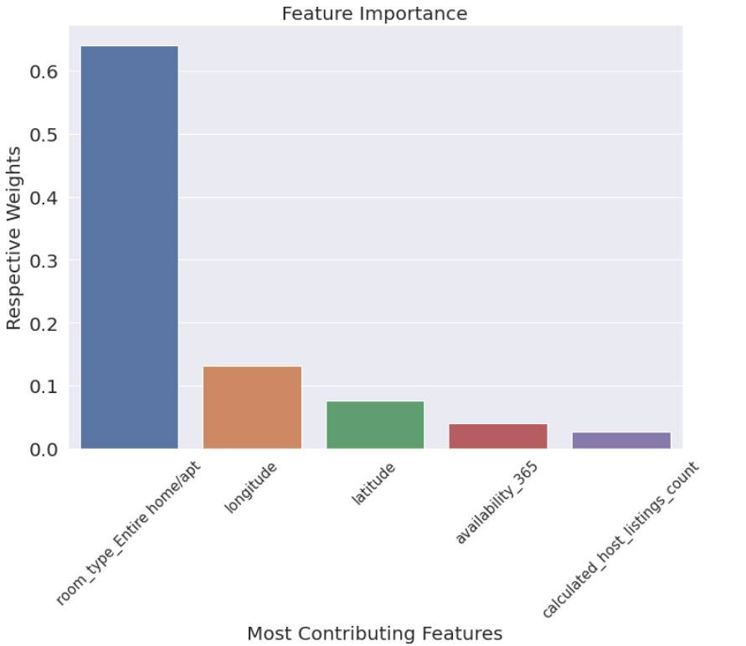
Feature Importance and Analysis
Room type is the most associated, which is common sense (bigger room for more people -> more expensive)
Longitude and latitude implies the location (Manhattan vs. Brooklyn)
Availability may indicate business positioning of the room (seasonal or all year round)

Slide 11
Conclusion
Gradient Boosting yields the best result with test accuracy of 72.2% with parameter tuning
Models help Airbnb owner to price their property
Model accuracy may impact the final result
Future Study:
More data, such as data for different cities
More features, such as rating and review ect.

Slide 12
Thank You!

